Slide 1
VOTER SUPPRESSION, CLIMATE JUSTICE,
& THE POLLUTER-INDUSTRIAL COMPLEX
How the Corporate Assault on American Democracy &
The Climate Are Connected
RESEARCHED AND WRITTEN BY:
Daniel Faber and Kayla Vestergaard, with Nina Schlegel and Claire Spector.

Slide 2
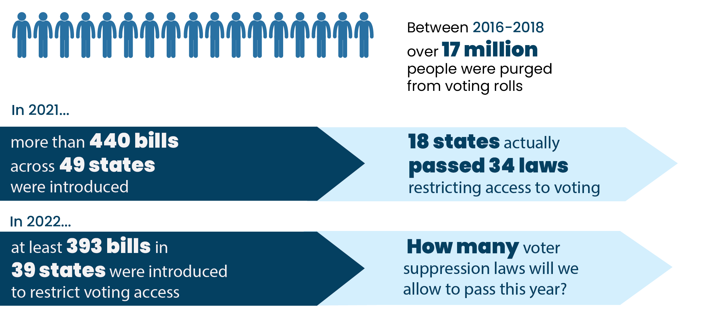
The greatest rollback of voting rights since the passage of the Voting Rights Act of 1965
These laws include:
the adoption of harsh voter ID requirements
making voting by mail and/or early voting more difficult
purging legitimate voters from the rolls
limiting the number, location, and/or availability of mail ballot drop boxes in Democratic districts
dramatically reducing the hours and number of polling places in low-income communities of color
making voter registration more difficult
2023:
322 bills introduced
in 45 states
13 Restrictive Laws, 35 bills still active
Numbers from Brennan Center for Justice

Slide 3
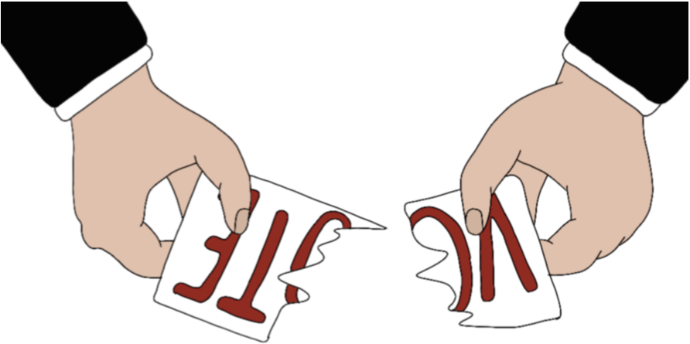
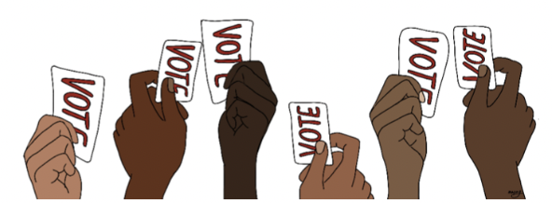
Voter Suppression Tactics Targeting Youth/POC
Legislation directly targeting the voting rights of these marginalized groups is a violation of civil rights:
Increasing voter-ID requirements
37% of Black people and 27% of the Latino/a population nationwide do not possess a valid driver’s license, compared to just 16% of the white population.
Reduction of number of ballots an individual can drop-off on behalf of other voters
Directly attacks Get Out the Vote organizing which assists the collection and drop off of ballots for Native populations that sometimes live hundreds of miles from the nearest drop-box or polling station
Limiting vote drop-boxes per county
Creates unreasonable travel distances in gerrymandered counties
Requirement of street-address instead of P.O. Box for mail-in voting
Many Native American Reservations do not have traditional street addresses

Slide 4
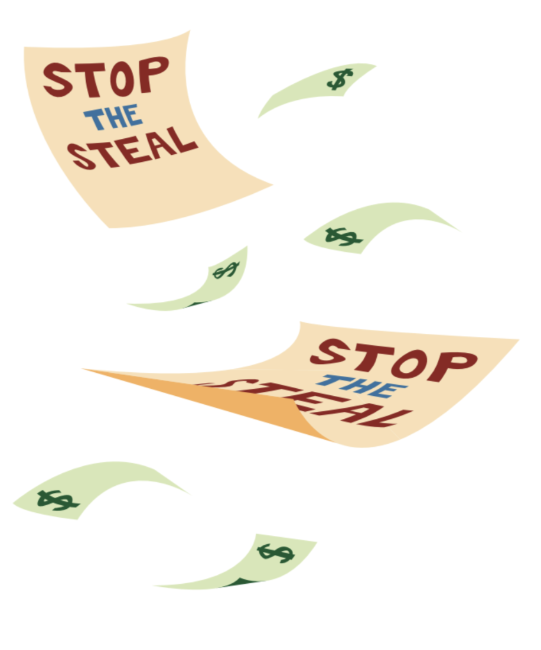
Seeding Distrust in America’s Electoral System
Under the frightening guise of “stopping widespread voter fraud,” the Republican Party and operatives of major corporate polluters are garnering support for their implementation of restrictive voter identification and access laws across the country, especially in red states.
All reputable studies have concluded that levels of such fraud in this country are virtually non-existent.
The most comprehensive investigation of voter impersonation found only 31 different incidents of voter fraud out of a billion ballots from 2000 through 2014.
The Brennan Center found instances of voter fraud to be so exceedingly rare that it is more likely that an American “will be struck by lightning than impersonate another voter at the polls.”

Slide 5
The Corporate Assault on American Democracy
The current assault on American democracy is heavily bankrolled by conservative billionaires and the most environmentally destructive corporations in America. They have formed a sophisticated political network we call the Polluter-Industrial Complex (PIC).
sectors of Big Business that would stand to profit the most from a weakening of environmental regulations, public health and safety measures, and climate change legislation.
Includes most prominently: major polluters such as the oil & gas industry, tobacco companies, petrochemical corporations, agribusiness, utilities, timber & mining interests, railroads, the auto industry, and insurance that is invested in fossil fuels.

Slide 6
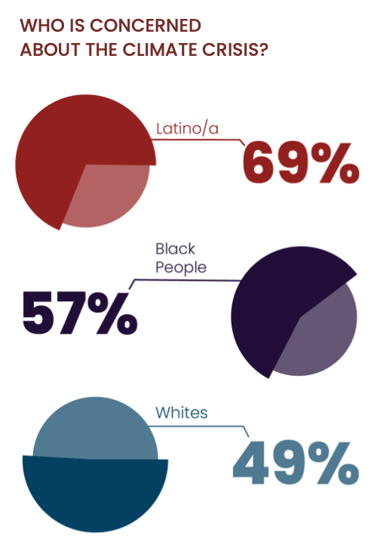
Struggles for Climate Justice & Voting Rights Are Linked
The reason for this assault is simple: Indigenous peoples, Asian-Americans, Black and Brown communities and young people are on the front lines of climate change and the ecological crisis, and are most likely to support environmental regulation and political candidates with the strong pro-environment records.
Thus, the current voter suppression efforts, which disproportionately target these marginalized groups, aim to disrupt support for environmental/climate justice and protect the profits of the PIC.

Slide 7
Oil-igarchy vs. Democracy
These organizations are being handsomely rewarded by the fossil fuel industry for their efforts.
At least $9.7 billion in donations was channeled by the Polluter-Industrial Complex (PIC) to some 128 organizations working against climate change legislation an/or the rollback of voting rights (2003-2018).
A prime example is ExxonMobil which provided nearly $33.8 million in funding to think tanks and policy institutes working on climate denialism and/or other conservative causes from 1997-2015. Some $9.2 million of which went to the Heritage Foundation, Federalist Society, ALEC, as well as the American Enterprise Institute (AEI) and the Competitive Enterprise Institute (CEI).
Charles Koch is a prominent funder of Donors Trust and Donors Capital Fund—two dark money vehicles that direct and conceal donations by wealthy conservatives to the causes of the PIC. Both entities bankroll numerous voter suppression groups
The Judicial Education Project ($47.5 million from 2011 to 2018) the Public Interest Legal Foundation ($600,000 since 2016), True the Vote ($150,000 from 2013 to 2017), and Judicial Watch ($218,000 since 2010).
The Heritage Foundation – parent of the Election Law Reform Initiative -- has received about $1 million from the Charles Koch Foundation since 2014

Slide 8
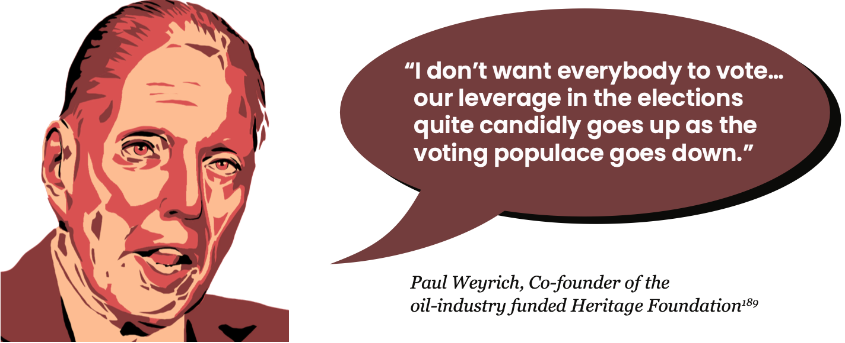
Organizations Leading the Assault On Voting Rights & the Climate
The Heritage Foundation
A prominent conservative think tank in Washington, D.C. and parent of the Election Law Reform Initiative, which is pushing for mandatory ID laws and restrictions on mail-in voting, especially for first time voters.
The American Legislative Exchange Council (ALEC), which produces model laws and policies for state governments
Outsources voter restriction work to the prominent dark money group Honest Elections Project, which works on election issues that would address redistricting, ballot measures, and election law, working to create model legislation to further voter suppression efforts.

Slide 9
Koch-ed Up on Voter Suppression & Climate Denial
Koch Industries PAC, representing petrochemical and fossil fuel services, is the fourth largest donor to coup-supporting politicians, illustrating the network’s deep commitment to the polluter-industrial complex’s voter suppression agenda.
The Charles Koch Foundation has donated about $1 million to The Heritage Foundation – which promoted the myth of “voter fraud” for many years while opposing mail-in voting and other voting rights reforms – since 2014.
Between 2015–2020, Koch Industries contributed $293,000 to state legislators supporting voter suppression bills.
Koch-related foundations have poured over $145 million directly into 90+ groups attacking climate science and policy over the past 20 years.

Slide 10
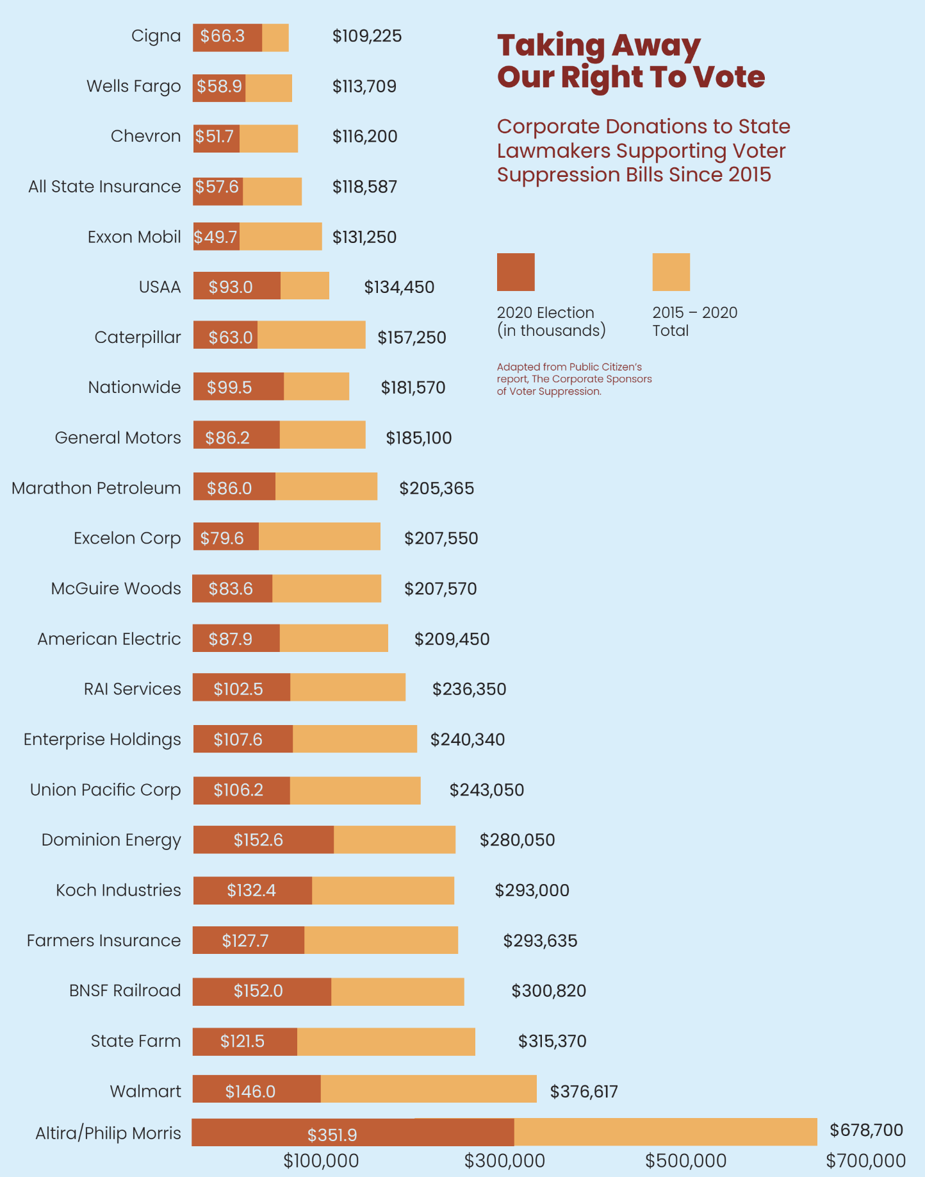
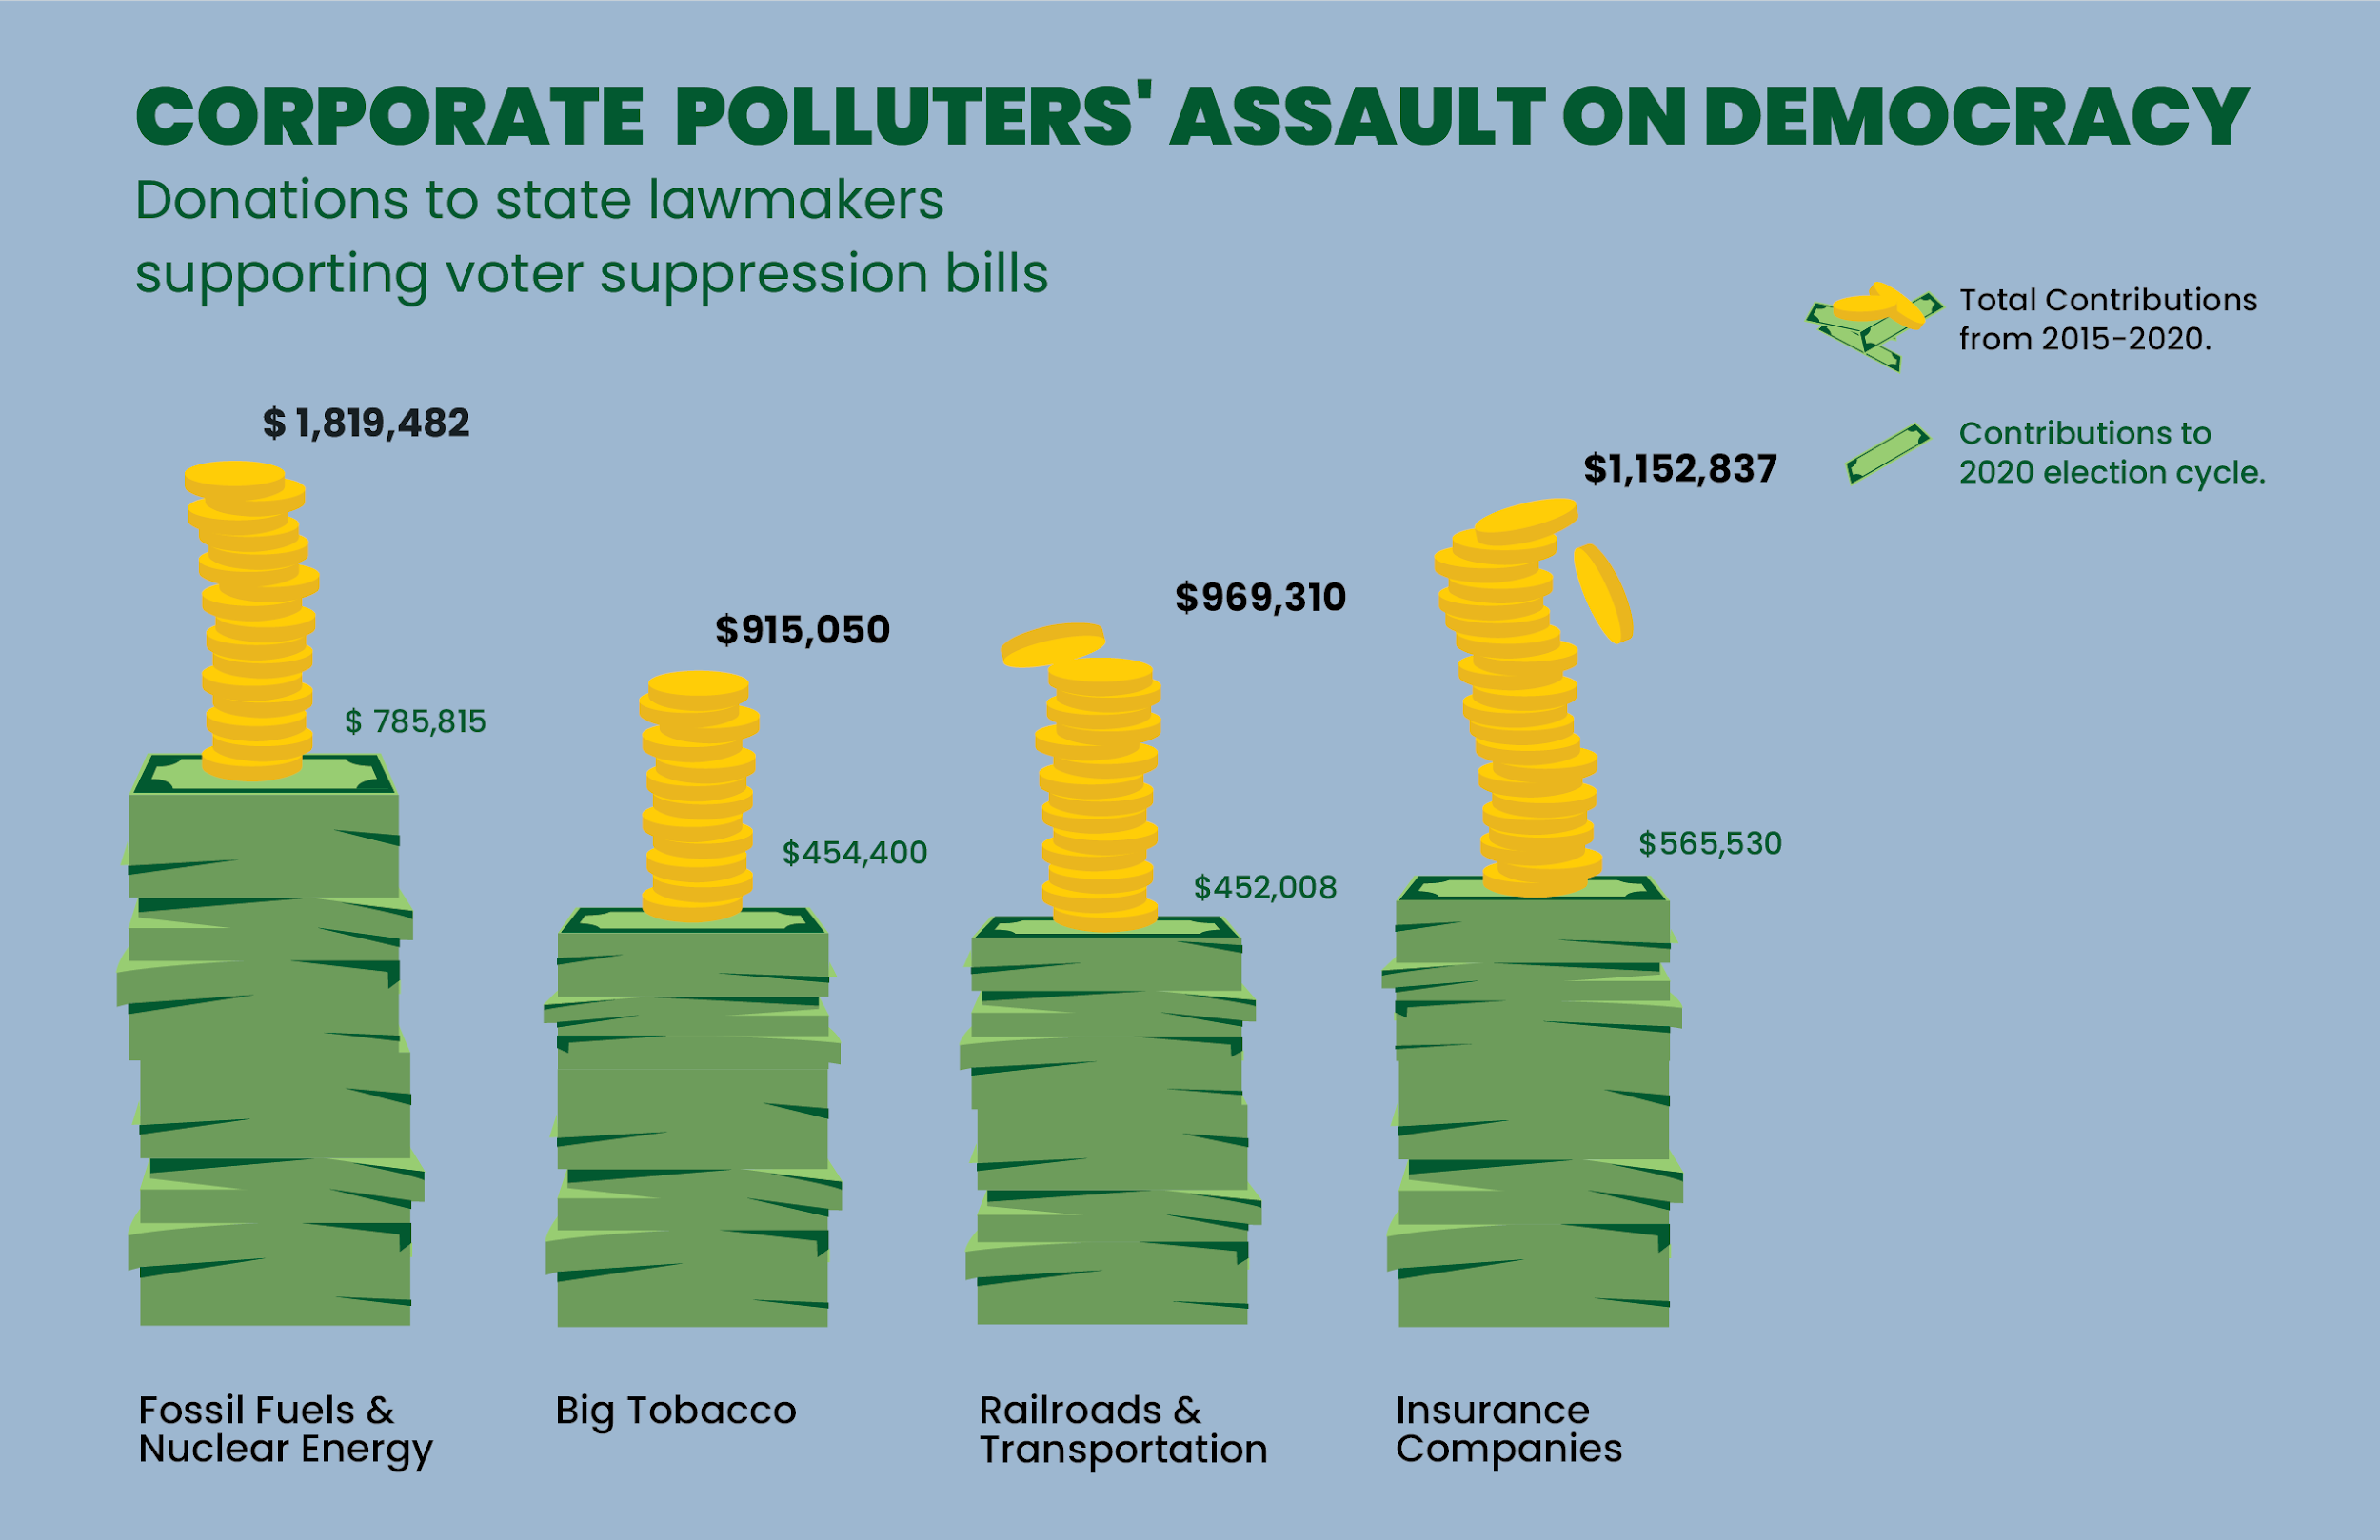

Slide 11
Railroading our Democracy and the Climate…
The railroad industry is at the center of the climate change countermovement, having long been a player in corporate coalitions working to undermine climate regulations. They have been major actors in the climate denial Cooler Heads Coalition run out of the Competitive Enterprise Institute.

Slide 12
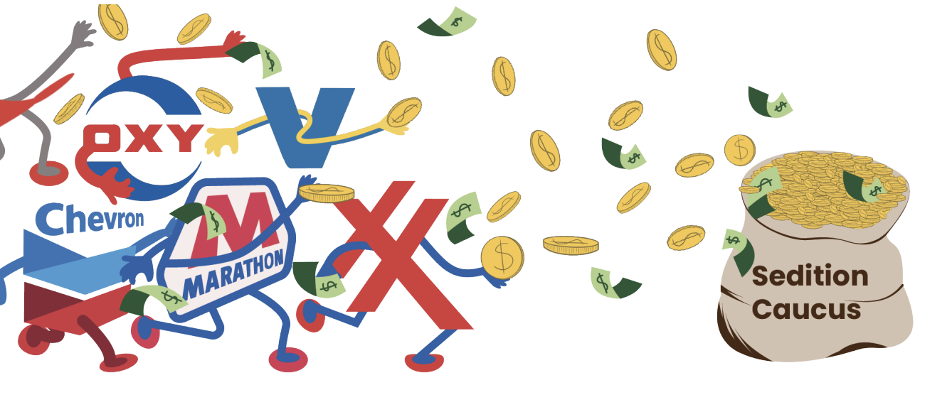
The Polluter-Industrial Complex: Profiting from the Big Lie
Six of the biggest fossil fuel companies in America – Valero Energy, Marathon Petroleum, ExxonMobil, Chevron, Occidental Petroleum, and ConocoPhillips – have given nearly $700k to the campaign and leadership PACs of the 147 Republican members of Congress who voted against certifying the election.
In total, some 1,074 corporations and industry group PACS have given over $27.5 million to the Sedition Caucus members and allied committees.
This coup attempt is still underway now, although the strategies and tactics have changed. Fueled by the Big Lie, this effort picks up where last year’s insurrection left off by putting in place the pieces to steal future elections by systematically taking over every aspect of the voting process.

Slide 13
What’s At Stake? More Than You Think.
Nina
Loss of critical advancements in climate, energy and environmental justice legislation, regulation, and other actions.
New threats to the democratic process going unchallenged: from the use of social media to micro-target voters with misinformation, curbing direct democracy (ballot measures), to replacing nonpartisan election officials
A concentration of power by corporate billionaires and the PIC working to fund Right-wing populists, white supremacists, and authoritarians.
Without state and federal voting rights legislation, more discriminatory voting laws are getting passed every year.

Slide 14
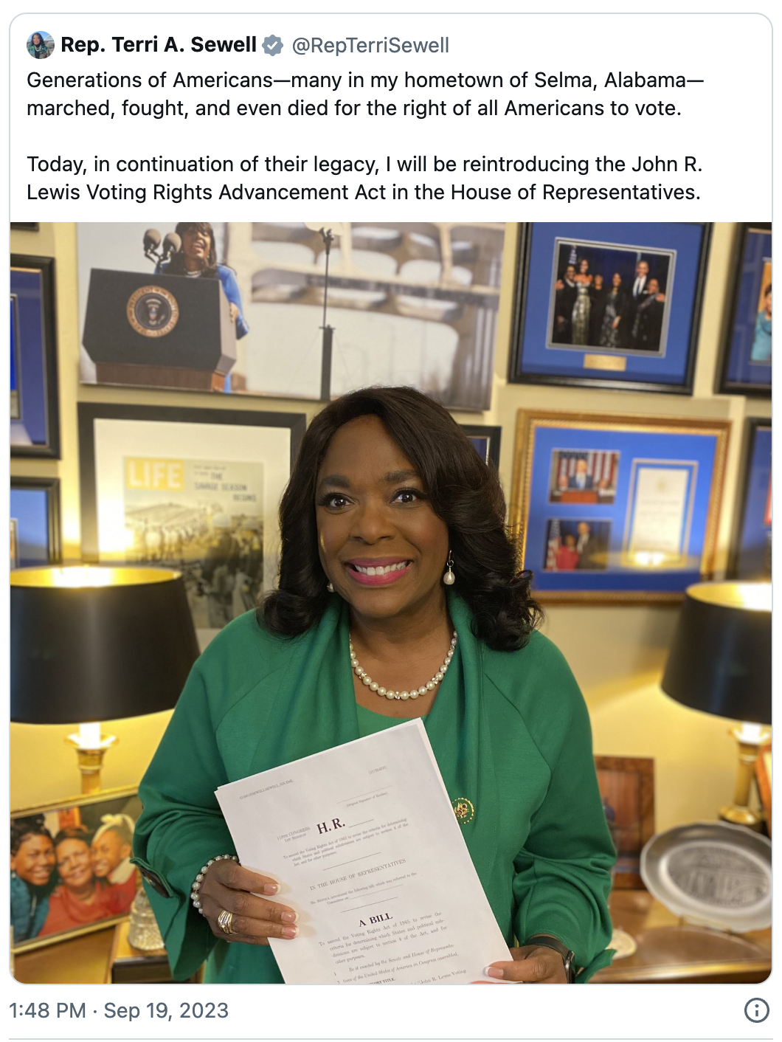
Big Goals: Federal Legislation
John Lewis Voting Rights
Advancement Act
Reintroduced by Rep. Terri Sewell
Fully enshrine the anti-discrimination legislation of the Voting Rights Act (VRA) of 1965 and reverse pre-clearance.
Pre-clearance prevented 700 discriminatory laws and forced another 800 proposed changes
Key provisions: new preclearance framework (recent evidence based, some apply nationally, practice-based coverage), vote dilution, vote denial, retrogression (protects against more discriminatory voting laws)
Campaign Finance
47 Senators support amendment to overturn the Citizens United decision.
In 2020, 19 States and D.C. called for a constitutional amendment for election spending reform, 803 local government resolutions
Reintroduced DISCLOSE Act 2023
Public campaign financing lowers the financial barriers for candidates to run in an election.
Some provisions in Freedom to Vote Act
NY State already implementing public financing
Freedom to Vote Act
Reintroduced by Sen. Amy Klobuchar and Rep. John Sarbanes
Automatic voter registration at DMVs; national 2-week early voting, national voting holiday; vote by mail without excuse, provisional voting w/o ID, limits voter purging, court-enforced redistricting standards, campaign finance oversight by Federal Election Commission, some campaign finance transparency, federal protections for election officials.

Slide 15
Medium Goals: Strengthening Democracy
State Legislation.
register voters automatically; allows people register on election day; hold early voting; and expand vote by mail.
Prevent states from purging the voter rolls based solely on unreliable evidence, like someone’s voting history.
Restore voting rights for formerly incarcerated people also crucial to confronting the nation’s legacy of racist voter suppression.
Ensure election rules are fair and transparent, election workers protected from intimidation, create clear election disputes standards through courts
Stay vigilant
against the passage of anti-democratic elections legislation like ACT (American Confidence in Elections Act/i.e. “Big Lie” bill)
Watching for election subversion/replacing nonpartisan officials

Slide 16
Today Goals: Get Strategic. Get Organized.
Get to Know your Voting Rights Allies.
Look Upstream at the Source of Injustices.
Join and Amplify Pro-democracy Coalitions.
Share Voting Rights Information & Track Bills.
Build Cross-Movement Power.

Slide 17
Thank you
Contact us:
Nina: nina@climatejusticecenter.org
Danny: dannyfaber@comcast.net
Instagram: /climatejusticecenter
X/Twitter: /CenterforCJ
www.climatejusticecenter.org

